Slide 1
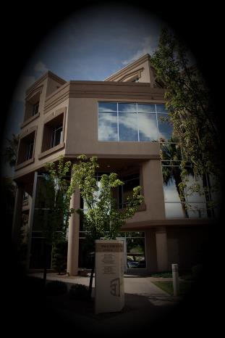
The Virtual Office
Notes:
Explain how I found out about virtual offices.

Slide 2
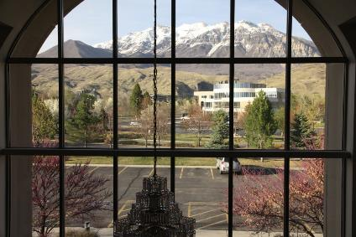
Types of Services Provided
Phone answering
Accounting
Website management
Meeting space
Professional address

Slide 3
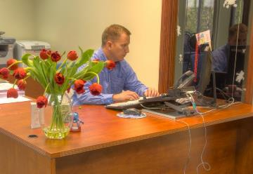
Phone Answering Service
Answer all calls
Take messages
Direct calls to “your” orders department
Direct calls to “your” billing department
Answer simple questions

Slide 4
Accounting
Accounts Receivable and Accounts Payable
Cash Management
Budgeting
Forecasting
Job Costing
Inventory Management

Slide 5
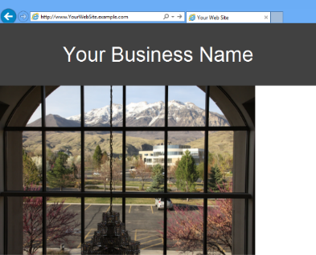

Website Management
Design
Hosting
Optimization for increased traffic
Frequent updating

Slide 6




Meeting Spaces
Reception Area
Training Room
Meeting Room
Cubicle (for
Work or
Interviews)
You can usually rent space by the hour, day, week, or month.

Slide 7
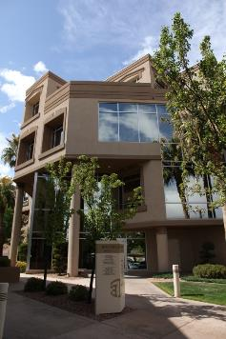
Professional Address
Use an address in more exclusive areas
Create locations in multiple cities
Mail can be forwarded to your physical location
Notes:
Some people just want a prestigious address. Or they do not want their home address known.

Slide 8
Economical Solution
Pay only for what you need
Much less expensive than leasing space
Perfect for people who
Work from home
Travel frequently
Want to establish a satellite office

